Slide 1
DOCUMENT TRACKING SYSTEM WITH SMS NOTIFICATION
Login with your DTS account
Username
Password
Remember me
LOG IN

Slide 2

Document Tracking System with SMS Notification
Dashboard
NOTIFICATION
ADMIN
Document Summary
Pending Documents
Dashboard
Documents
SMS Campaign
Recent Documents
Recent Activities

Slide 3
Document Tracking System with SMS Notification
Dashboard
NOTIFICATION
ADMIN
Document Summary
Pending Documents
Dashboard
Documents
Create New Record
Released Documents
Recent Documents
Received Documents
Office Documents
Recent Activities
SMS Campaign

Slide 4

Document Tracking System with SMS Notification
Documents
x
DASHBOARD
DOCUMENTS
SMS CAMPAIGN
NOTIFICATION
ADMIN
CREATE NEW RECORD
Fields with * are required
Attach File
Dashboard
File Name
*
Click here to choose file
Documents
Description
Create New Record
Type of Document
SMS Notification
*
Released Documents
Notify me whenever someone received this document
Name of Sender
Received Documents
*
Office Documents
Department
*
SMS Campaign
Type
*
Create Record

Slide 5
Document Tracking System with SMS Notification
Documents
NOTIFICATION
ADMIN
Pending for Release Documents
Document | Office | Last Modified | Status
DTS Sample File Unclassified | ICT 05/22/2021 01:15 PM shaina@sti.edu.ph | RECEIVED by ICT 05/22/2021 01:15 PM shaina@sti.edu.ph | PENDING | RELEASE
Thesis Proposal Templates Unclassified | GE 05/26/2021 10:45 AM zarah@sti.edu.ph | RECEIVED by GE 05/26/2021 10:45 AM zarah@sti.edu.ph | PENDING | RELEASE
Test Document Certificate of Service | GE 06/01/2021 09:10 AM nurullajie@sti.edu.ph | RECEIVED by GE 06/01/2021 09:10 AM nurullajie@sti.edu.ph | PENDING | RELEASE
Data Management Unclassified | ICT 06/02/2021 4:50 PM Nicole@sti.edu.ph | RECEIVED by ICT 06/02/2021 4:50 PM Nicole@sti.edu.ph | PENDING | RELEASE
Dashboard
Documents
Create New Record
Released Documents
Received Documents
Office Documents
SMS Campaign

Slide 6
Document Tracking System with SMS Notification
Documents
NOTIFICATION
ADMIN
Received Documents
Document | Office
DTS Sample File Unclassified | ICT 05/22/2021 01:15 PM shaina@sti.edu.ph | OPEN
Thesis Proposal Templates Unclassified | GE 05/26/2021 10:45 AM zarah@sti.edu.ph | OPEN
Test Document Certificate of Service | GE 06/01/2021 09:10 AM nurullajie@sti.edu.ph | OPEN
Data Management Unclassified | ICT 06/02/2021 4:50 PM Nicole@sti.edu.ph | OPEN
Dashboard
Documents
Create New Record
Released Documents
Received Documents
Office Documents
SMS Campaign

Slide 7
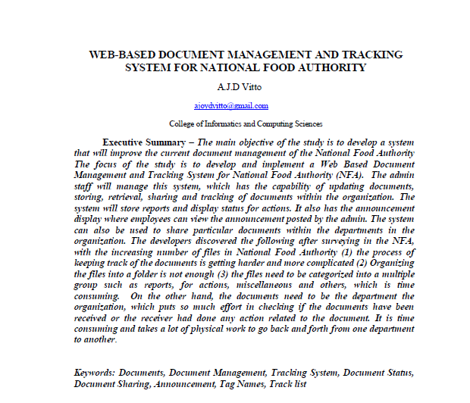
Document Tracking System with SMS Notification
Documents
NOTIFICATION
ADMIN
x
DASHBOARD
DOCUMENTS
REVIEW DOCUMENT
Received Documents
Document | Office
DTS Sample File Unclassified | ICT 05/22/2021 01:15 PM shaina@sti.edu.ph | OPEN
Thesis Proposal Templates Unclassified | GE 05/26/2021 10:45 AM zarah@sti.edu.ph | OPEN
Test Document Certificate of Service | GE 06/01/2021 09:10 AM nurullajie@sti.edu.ph | OPEN
Data Management Unclassified | ICT 06/02/2021 4:50 PM Nicole@sti.edu.ph | OPEN
Dashboard
Select a Review:
APPROVE
Documents
REJECT
Create New Record
NEEDS REVISION
RETURN
Released Documents
SMS Notification
Received Documents
Send a notification to confirm that you have received the document
Office Documents
SMS Campaign
Confirm

Slide 8

Document Tracking System with SMS Notification
Documents
NOTIFICATION
ADMIN
Office Documents
Dashboard
Search Document
Documents
File Name
File Description
Last Date Modified
Create New Record
DTS Sample File
Thesis Proposal Templates
HRIS
Documentation DTS
none
none
none
none
May 22, 2021
May 25, 2021
May 25, 2021
June 01, 2021
Released Documents
Received Documents
Office Documents
SMS Campaign

Slide 9
Document Tracking System with SMS Notification
SMS Campaign
NOTIFICATION
ADMIN
Username: Sam Smith
Create a Message
User ID: 0200011
Show Users
Dashboard
Send to:
Logout
+ 639 21 765 600
Documents
From:
Create New Record
ICT FACULTY
Released Documents
Enter your message:
Received Documents
Office Documents
SMS Campaign
Send

Slide 10
Document Tracking System with SMS Notification
Administrative Users
SMS Campaign
NOTIFICATION
ADMIN
Username: Sam Smith
Create a Message
User ID: 0200011
New User
Show Users
Dashboard
Send to:
Logout
Nicole Mancao
+ 639 21 765 600
Documents
Shaina Daud
From:
Create New Record
ICT FACULTY
Released Documents
Zarah Bagundang
Enter your message:
Received Documents
Nurullajie Abdullah
Office Documents
Shaina Ventrusa
SMS Campaign
Danielle Lim
Send

Slide 11

Login with your DTS account
Username
Password
Forgot password?
LOGIN
Not registered? Register here

Slide 12
Forgot your password?
Please enter either your email address or phone number to find your account
Enter your email address:
daud.shaina12@cotabato.gov.ph
Cancel
Search

Slide 13
Forgot your password?
Please enter either your email address or phone number to find your account
Enter your phone number:
+639 06 94 66 415
Cancel
Search
Enter your email instead

Slide 14
Forgot your password?
Password Help
Please enter either your email address or phone number to find your account
Shaina Daud
Employee
Enter your phone number:
+639 06 94 66 415
Get a verification code on my phone ********415
Cancel
Search
Continue
Enter your email instead

Slide 15
Get a verification code
Enter the Code We Sent To +********41
The verification code is a 6-digit number.
Enter Code:
186631
Continue
Send SMS Again

Slide 16
Reset Password
The password should have at least 8 characters
New password:
Enter password
Confirm password:
Confirm password
Reset Password

Slide 17
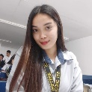
Dashboard
20+
Mancao, Nicole
MAILBOX
|
Search
ICT Department
Request Account
My Recent Documents
Dashboard
GE Department
THM Department
Remove
Show
5
Requests
CE Department
Documents
BACOMM Department
DTS _Sample_File.docx
June 02, 2021 10:20 am
Name:
Marquez, John
Phone #:
09342567811
SMS Campaign
Department:
GE Department
Video_presentation_proposal.mp4
June 03, 2021 2:00 pm
Name:
Balmond, Leo
Image01.jpeg
June 03, 2021 8:00 pm
Phone #:
09067889901
Department:
ICT Department
Data.jpeg
June 11, 2021 6:00 am
Name:
Alucard, Jean
Repositories
Phone #:
09065543789
Department:
THM Department
Name:
Magdalena, Layla
Office Files
My videos
My Images
Phone #:
09753566189
Department:
CE Department
E-certificates
My Documents

Slide 18
Dashboard
20+
Mancao, Nicole
MAILBOX
GE Department
Search
Request Account
My Recent Documents
Dashboard
Show
5
Requests
Remove
Documents
Name:
Marquez, John
DTS _Sample_File.docx
June 02, 2021 10:20 am
Phone #:
09342567811
SMS Campaign
Department:
GE Department
Video_presentation_proposal.mp4
June 03, 2021 2:00 pm
Name:
Balmond, Leo
Image01.jpeg
June 03, 2021 8:00 pm
Phone #:
09067889901
Department:
ICT Department
Data.jpeg
June 11, 2021 6:00 am
Name:
Alucard, Jean
Repositories
Phone #:
09065543789
Department:
THM Department
Name:
Magdalena, Layla
Office Files
My videos
My Images
Phone #:
09753566189
Department:
CE Department
E-certificates
My Documents

